Slide 1

Village of Amityville Commercial Revitalization Fund
Kathy Hochul Governor

Slide 2


DRI Recap- Village of Amityville Awards
Implement Complete Streets on Broadway
Revitalize LIRR Station and Connections to Downtown
Develop Mixed-Use Building at 21 Greene Avenue
Implement a Commercial Storefront Revitalization Fund
Rehabilitate Professional Office Building at 137-157 Broadway
Restore Losi’s Corner & Hook and Ladder No1. Building
Renovate 140a Broadway into Mixed-Use Dining & Office Building
Create New Eatery at 217 Broadway
Establish Artists’
Studio at 187 Broadway
Install Outdoor Beer Garden at 136 Broadway
Coordinate Village Wayfinding, Branding & Marketing

Slide 3
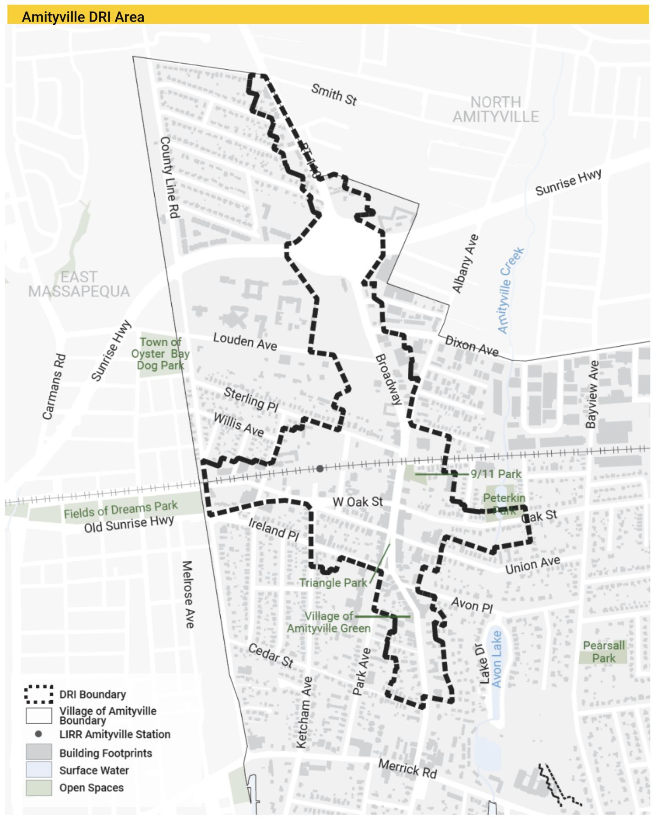
Eligible Area

Slide 4



Program Basics
Façade Improvement program funded by the DRI for Economic Development
Criteria for selection:
Projects that are visually prominent downtown
Projects with historic value or historic properties in danger of being lost to disrepair or damage
Projects that will reduce blight/contribute to economic recovery of downtown or stabilize/expand downtown business

Slide 5
Program Basics
Criteria continued:
Projects where assistance will create jobs
Projects where assistance will allow business to expand service offerings
Projects must be within the designated boundary

Slide 6
Program Basics
Project scoring:
Readiness- feasibility, proof of ownership, 100% financing in place, reasonable construction timeline
Physical impact- visually prominent downtown, historically significant, bringing into compliance with design and codes, transformative beyond normal maintenance
Economic Impact-leveraging grant funds with private investment, contribute to economic recovery, stabilize or expand tax base, businesses or jobs
DRI Priorities-projects that advance the goals and priorities of the DRI Investment Strategy

Slide 7
Funding
$600,000 total funding:
Large Projects ($25,000-$100,000 project cost): $300,000
Small Projects ($500-$25,000 project cost): $100,000
Building Murals: $100,000
Architectural/Engineering/Environmental Testing: $40,000
Administration of program: $60,000

Slide 8
Funding
Reimbursement program- 80% of eligible costs reimbursed upon completion of project.
Total project cost to determine 80% based on the lowest of bid (two minimum).
If more expensive contractor is selected, applicant is responsible for the difference in cost

Slide 9
Eligible Projects
Exterior building renovations for commercial and mixed-use spaces, façade/storefront renovations
Small projects: permanently affixed signage and awnings and minor exterior painting
Building Murals
Exterior improvements to support adjusted business practices, e.g. pick-up windows outdoor seating areas

Slide 10
Ineligible projects
Ineligible uses of funds include:
Acquisition costs
Improvements to structure owned by religious or private membership-based organizations
Improvements to municipally owned and municipally operated buildings

Slide 11
Ineligible projects
Funds may not be used for site work or ancillary activities on a property including but not limited to the following:
Furnishings
Appliances
Electronics
Tools
Disposable supplies
Business equipment
Non-permanent fixtures
Temporary artwork
Site work or ancillary activities including:
Septic systems/laterals
Grading
Parking Lot
Sidewalks
Patios
Decks
Garages
Sheds
Landscaping
Fences
Free standing signs
General maintenance
Repairs

Slide 12
Ineligible projects
Ineligible business activities include:
Inventory
Rent or lease expenses
Working capital
Other undefined expenses that do not sustain business operations
Funds can not be used for participant, participant’s family or staff labor
For reimbursement of materials only

Slide 13
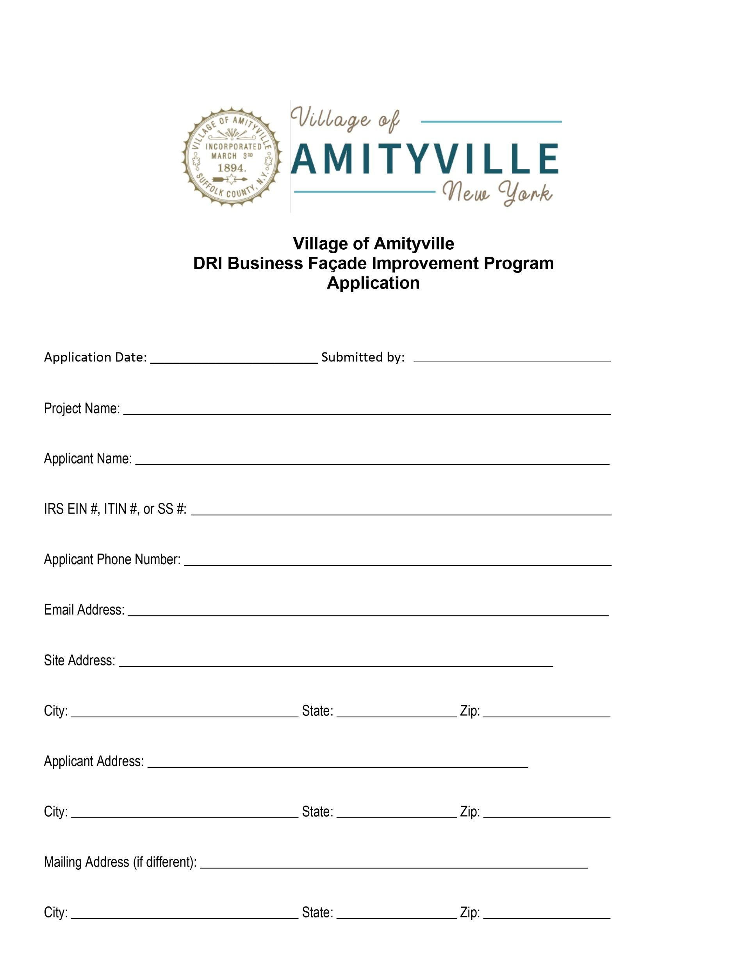
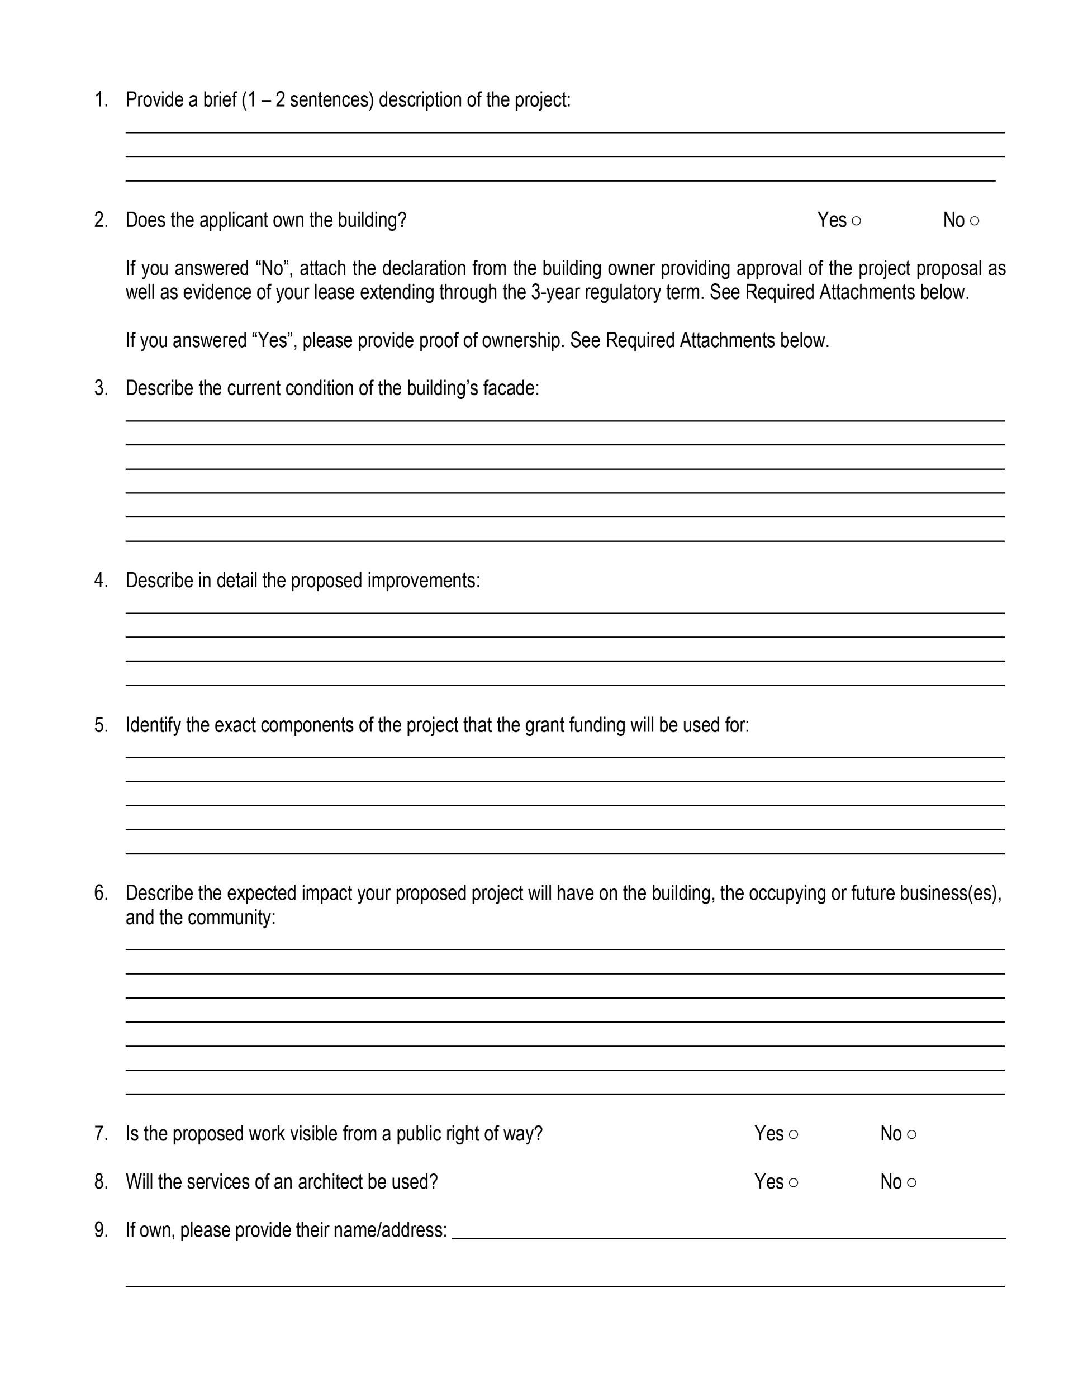
Application

Slide 14
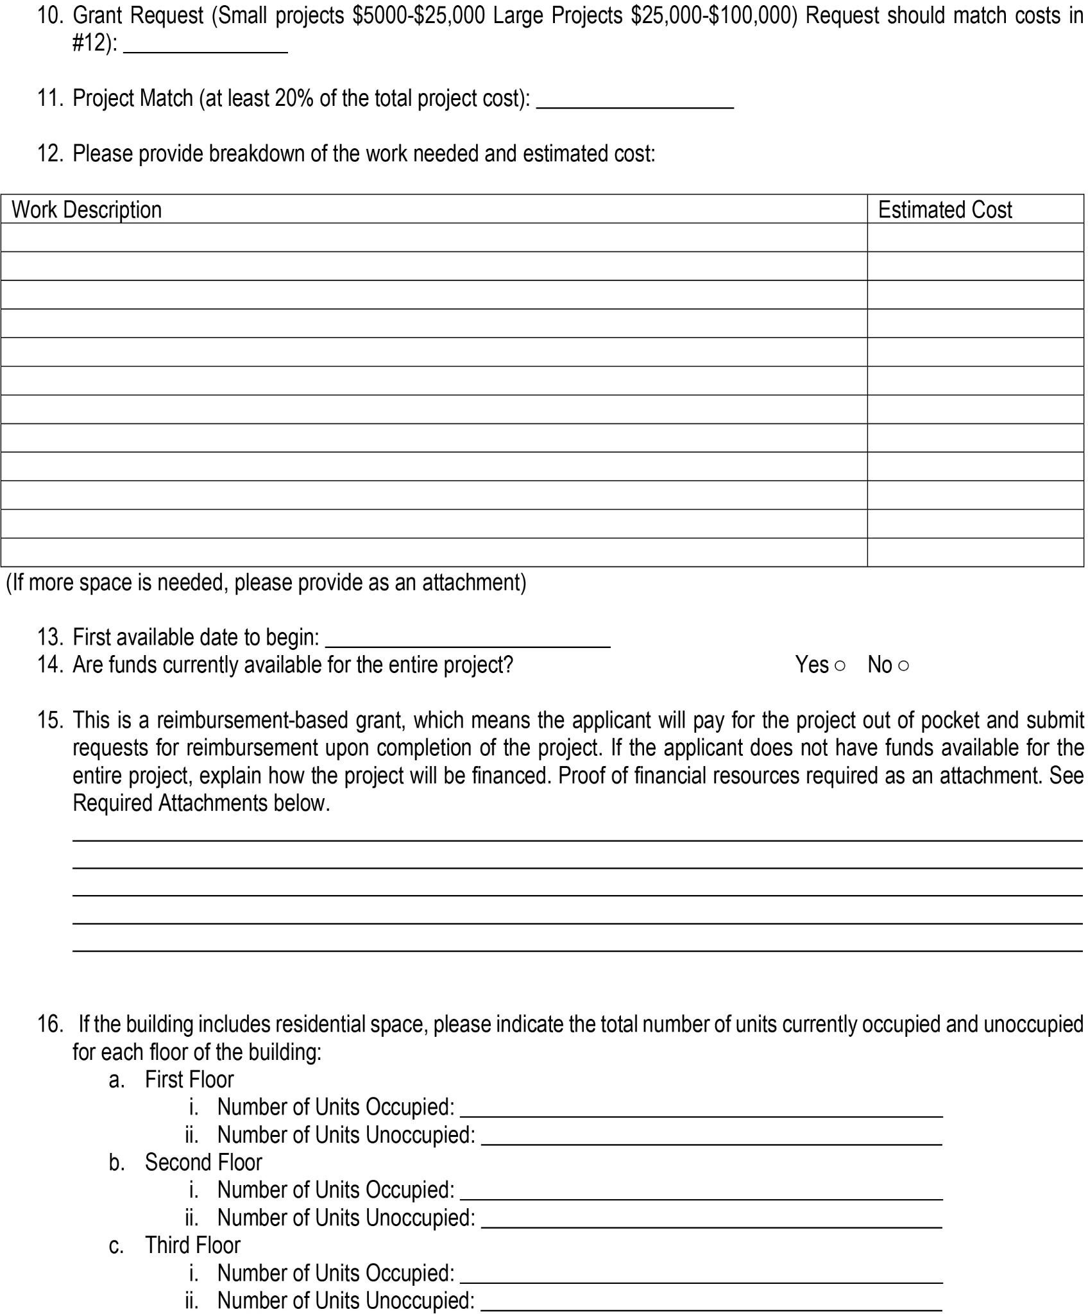
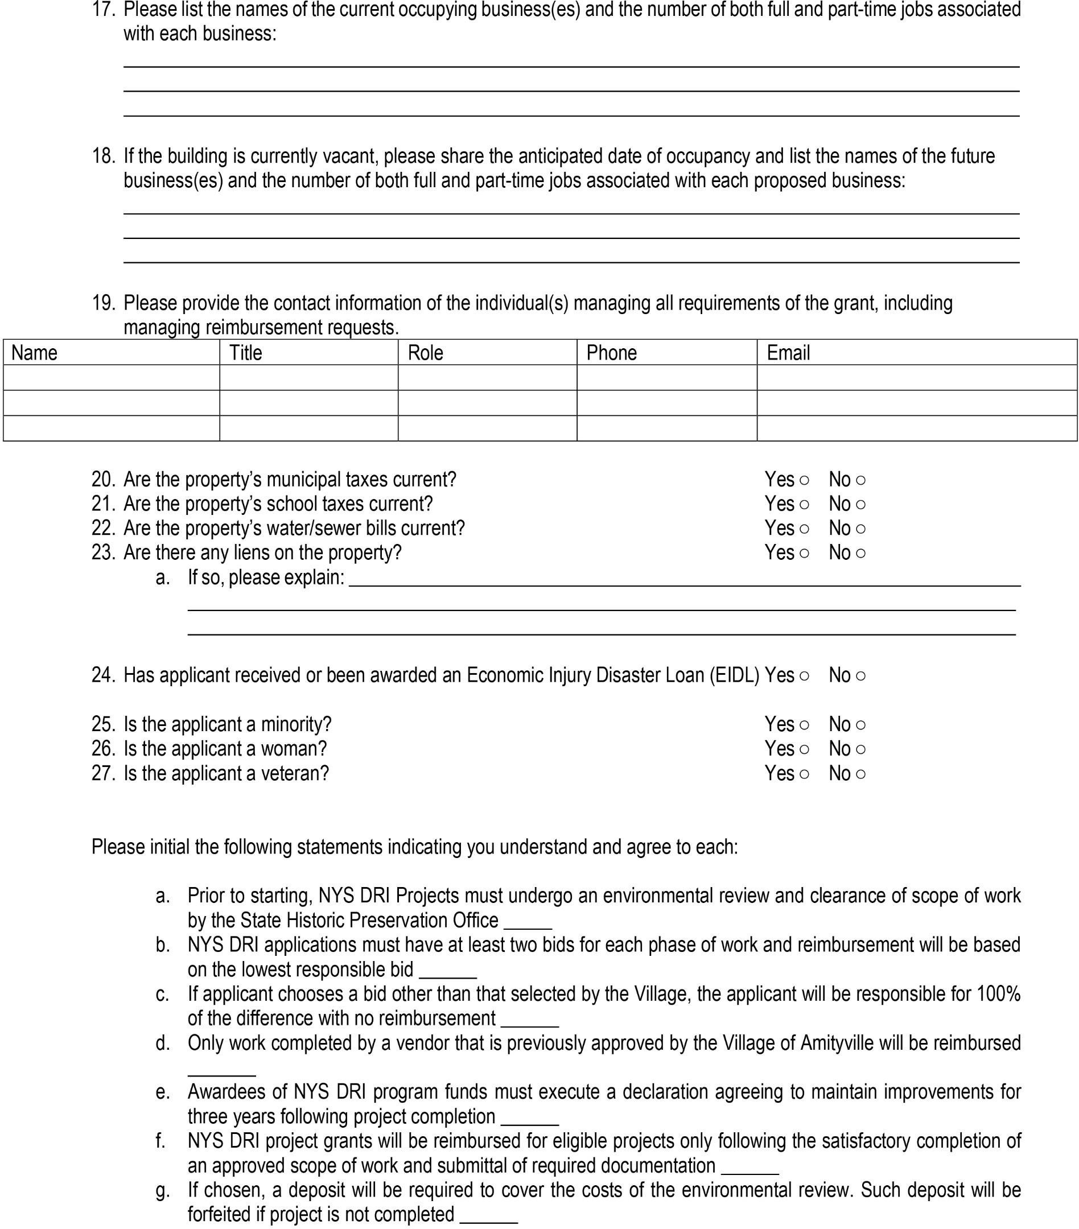
Application

Slide 15
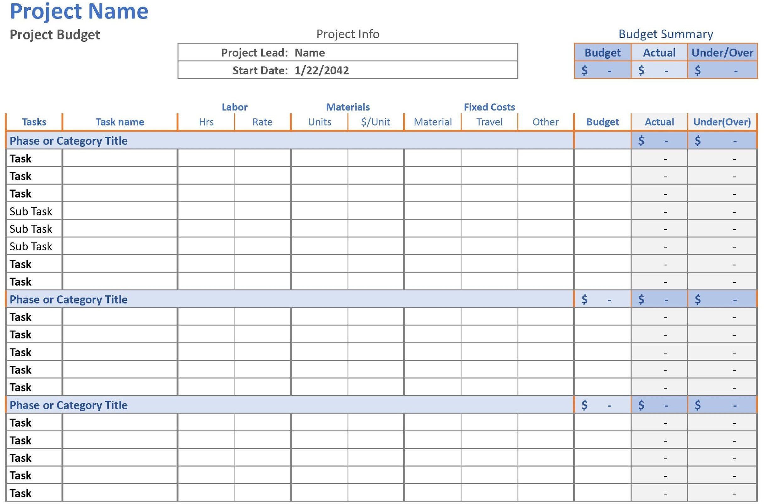
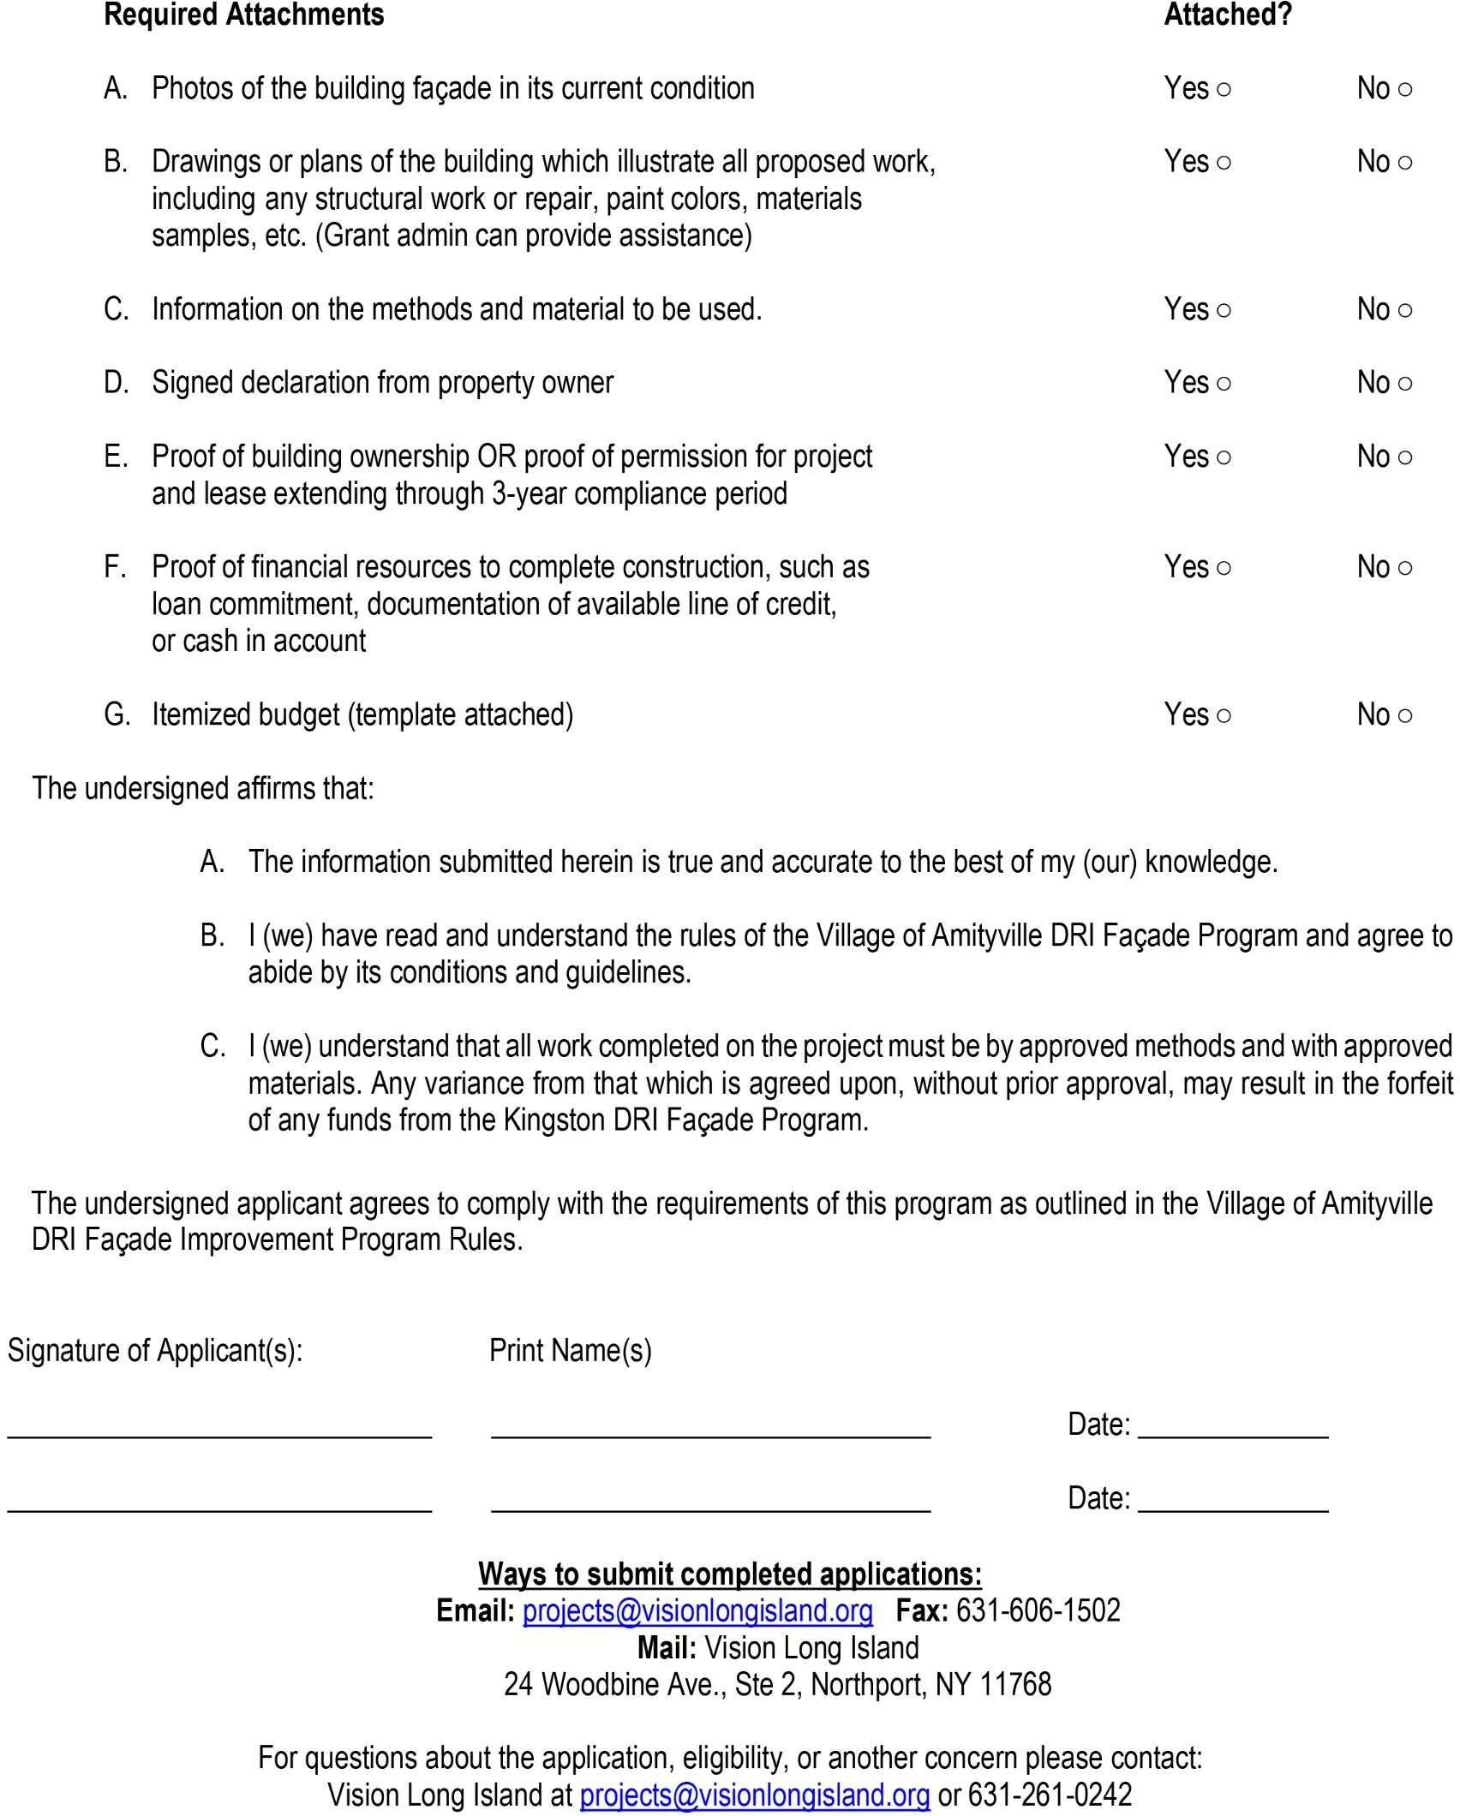
Application

Slide 16
Process/Timeline
Outreach to property owners and tenants
Assistance to applicants with design and application process
Application deadline March 1st
Review and selection of projects for funding – March 21st
Submit to NYS for approval- April 1st
Announcement of winners- April 15th
Deposit from chosen projects for environmental testing
(1 week after notification of award)

Slide 17
Process/Timeline
The following will vary depending on the project:
Environmental testing, reporting and historic review
Bidding process for contractors
Selection of contractor
Construction
Issue of Certificate of Occupancy by Village
Submit to NYS for reimbursement
NYS approves and releases reimbursement

Slide 18
Reimbursements
Property owners are responsible for the total cost of the project
Grants will reimburse property owners at the conclusion of the project after all cost are paid.
Proof of available financing through cash in bank, secured loan commitments and or project lines of credit is required.
No reimbursement should be requested until inspections of the work has been completed by LPA or its representative.

Slide 19
Reimbursements
No reimbursement should be requested until inspections of the work has been completed by LPA or its representative.
To sustain work cost, owners must provide the following:
Written contracts
Bank documents
Copies of invoices
Cancelled checks
Lien releases
Any other documents deemed reasonably necessary by the LPA or required by HFTC to maintain effective internal controls
Cash payment/cash receipts are NOT permitted and will NOT BE REIMBURSED

Slide 20
FAQs
Can I sell my building after making improvements? If you sell your building immediately after reimbursement, you will have to repay the funding. Each year you own the building after reimbursement the repayment amount reduces by 20% until after five years, there is no repayment required
Do I have to have my own architect or engineer? You may need architectural plans depending on the scope of your project. Typically where a description and sketch are not enough to convey your desired design. The program administrators can assist in preparing concept sketches for submission if needed.
Do I have to have the money up front? Yes, this is a reimbursable grant. Construction financing or other funds will be needed to make the improvements of which 80% of eligible funds will be reimbursed upon completion.
Does the grant cover repairs I already did? No, only approved improvements made after selection as a recipient are eligible for reimbursement.
Does the grant cover the inside of my business? No, this grant covers exterior improvements to the building only.
Can I use my own contractor to do the work? The program will provide a list of eligible contractors including MWBE companies to choose from to bid on the project. You can use your own contractor as long as there is no conflict of interest and the meet the requirements of the state. Regardless of contractor chosen by the participant, reimbursement will only be 80% of the lowest bid. Any cost incurred over and above are the responsibility of the participant

Slide 21
Contact Info
Vision Long Island
Phone: 631-261-0242
Email: Projects@visionlongisland.org
Website: www.AmityvilleDRI.com
Village Hall of Amityville

Slide 22
Village of Amityville Commercial Revitalization Fund
Kathy Hochul Governor

