Slide 1


2021 COMPLETE STREETS SUMMIT
COVID-19 RESPONSE
Streets as Mercantile Spaces
Michael A. Levine, AICP
Commissioner of Planning
March 26, 2021

Slide 2
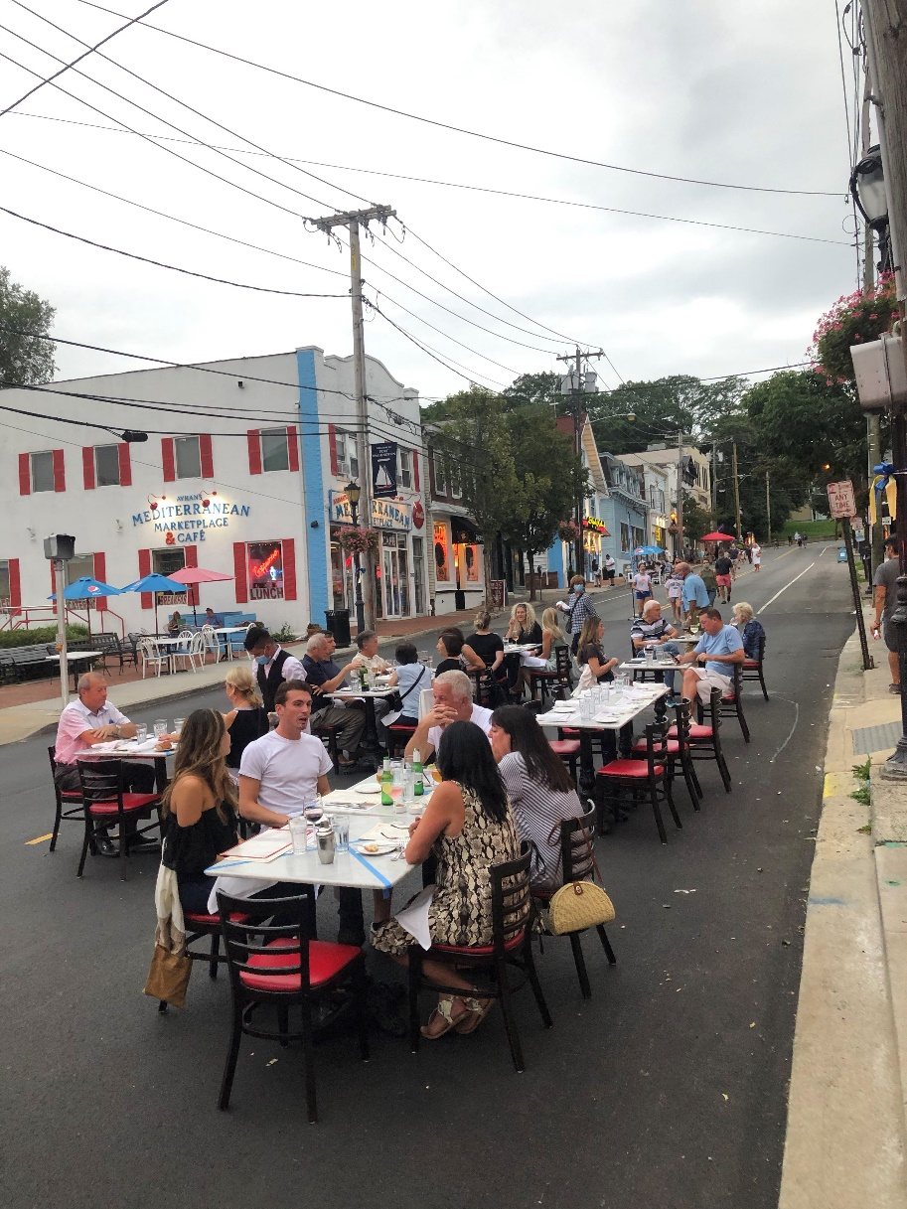
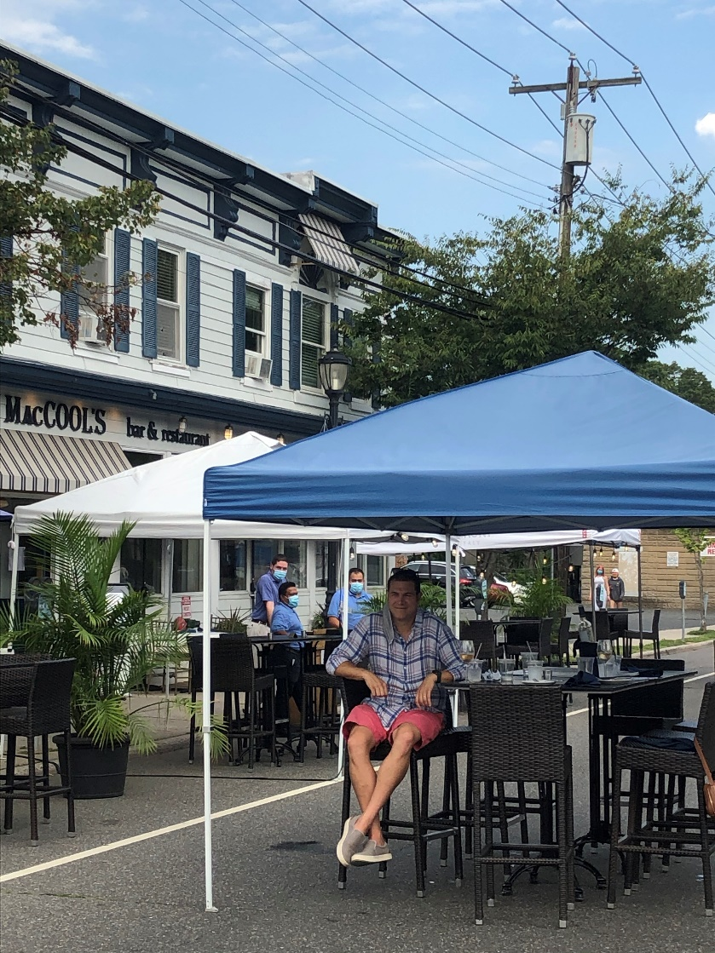
Streets as Restaurants?
COMPLETE STREETS
MARCH 26, 2021

Slide 3

The Challenge:
Executive Order 202.97
restricting indoor capacity
COMPLETE STREETS
MARCH 26, 2021

Slide 4

The Response:
Step 1: Panic
Step 2: Form a Committee!
COMPLETE STREETS
MARCH 26, 2021

Slide 5
Covid-19 Response
Business Recovery Workgroup
The Members:
Building Dept
Planning Dept
DPW/Highways
Town Attorney
Community Development Agency
Chambers of Commerce
COMPLETE STREETS
MARCH 26, 2021

Slide 6
Covid-19 Response
Business Recovery Workgroup
The Mission:
Outdoor Dining
Fitness/Salons
Road Closures
Park Dining Zones
Sidewalk Sales
Tent Permits
COMPLETE STREETS
MARCH 26, 2021

Slide 7
Concerns/Problems:
Parking
Emergency Response
ADA/Accessibility
Fire Hazards
Traffic Conflicts
COMPLETE STREETS
MARCH 26, 2021

Slide 8
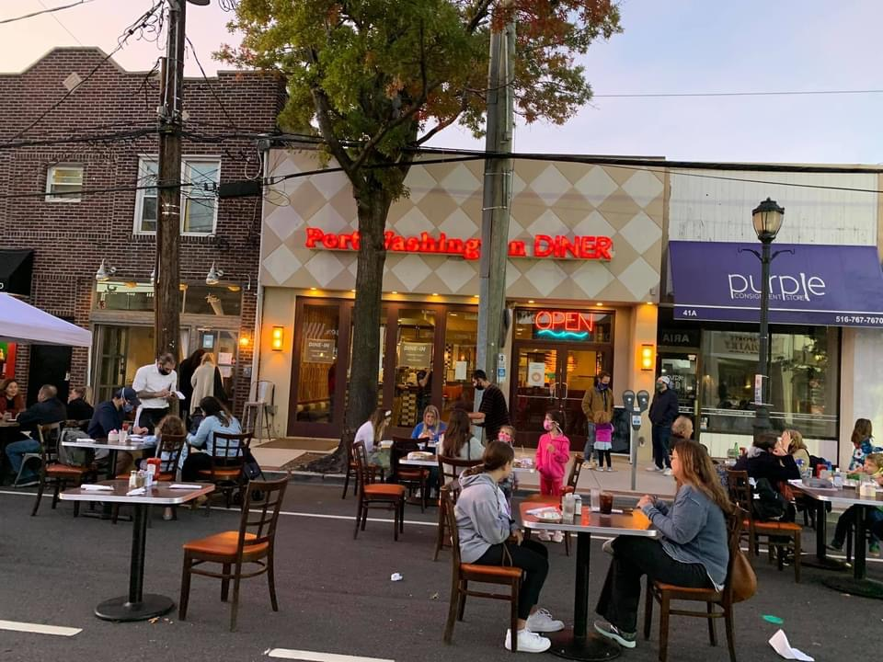
Main Street, Port Washington
COMPLETE STREETS
MARCH 26, 2021

Slide 9
Municipal Action: Supervisor Bosworth offered the following resolution and moved its adoption, which resolution was declared adopted after a poll of the members of this Board:
WHEREAS, the Town Board, as the legislative body of the Town of North Hempstead is empowered to amend the Town Code pursuant to the provisions of Article 9 of the New York State Constitution, the Town Law, and the Municipal Home Rule Law; and WHEREAS, this Board wishes to set a date for a public hearing to consider the adoption of a Local Law amending Chapter 70 of the Town Code entitled “Zoning” in order to assist those establishments required to operate at reduced seating capacity due to an anticipated executive order from the Governor. The local law will temporarily suspend certain regulations regarding the provision of additional seats and provide a framework for temporary outdoor seating. NOW, THEREFORE, BE IT RESOLVED that a public hearing be held by this Board on June 18, 2020, at 7:00 P.M. in the Town Board Meeting Room, Town Hall, 220 Plandome Road, Manhasset, New York, for the purpose of considering the adoption of the Local Law amending Chapter 70 of the Town Code entitled, “Zoning” in order to assist those establishments required to operate at reduced seating capacity due to an anticipated executive order from the Governor. The local law will temporarily suspend certain regulations regarding the provision of additional seats and provide a framework for temporary outdoor seating; and be it further RESOLVED that the Town Clerk be and hereby is authorized and directed to publish a notice of the hearing as required by law, which notice shall be in substantially the following form:
COMPLETE STREETS
MARCH 26, 2021

Slide 10
Outdoor Dining Rules:
50% of approved capacity may be moved outdoors
Wind screens to contain loose objects
No outdoor bars or service areas
Must be 50’ from residential property, except in mixed-use districts
Food waste must be disposed of inside building
Curfew: 10:00 weeknights and 11:00 weekends
5’ clear zone for sidewalk dining
Sidewalk service may use two adjacent storefronts
8’ from seating area to parking space or drive aisle
Cannot use fire lanes
COMPLETE STREETS
MARCH 26, 2021

Slide 11
Outdoor Dining Rules:
Simplified permit application
Waived any requirement to modify existing approvals
Can expand beyond confines of property
Did not require additional parking
COMPLETE STREETS
MARCH 26, 2021

Slide 12
Parklet/Parking Lane Seating:
Protection barriers must be 18” wide and 36” tall
Barriers must be marked with reflective devices/tape
Seating area must provide ADA ramp access
Prohibited within 15’ of fire hydrant
Prohibited within 8’ of a crosswalk
May expand to adjacent storefronts
COMPLETE STREETS
MARCH 26, 2021

Slide 13
Tents:
Was: 15 days
Now: 6 months
Sidewalk Sales:
Was: 3 days, 5/yr
Now: no limit
COMPLETE STREETS
MARCH 26, 2021

Slide 14

Promotion
COMPLETE STREETS
MARCH 26, 2021

Slide 15
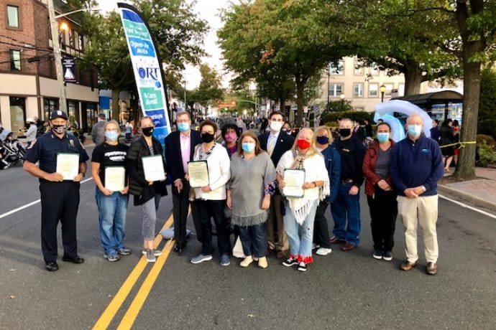
Promotion:
COMPLETE STREETS
MARCH 26, 2021

Slide 16
Approved Permits:
32 Restaurants
2 Gyms/Fitness Studios
1 Religious Event
3 Sidewalk Cafes
COMPLETE STREETS
MARCH 26, 2021

Slide 17
Main Street, Port Washington
COMPLETE STREETS
MARCH 26, 2021

Slide 18
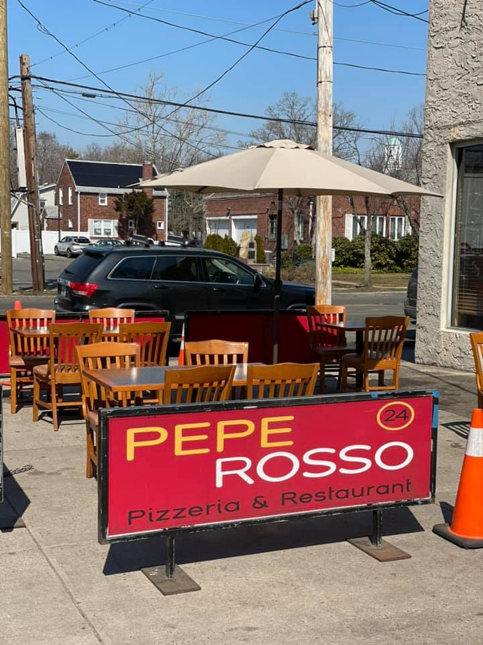
The Future:
COMPLETE STREETS
MARCH 26, 2021

Slide 19
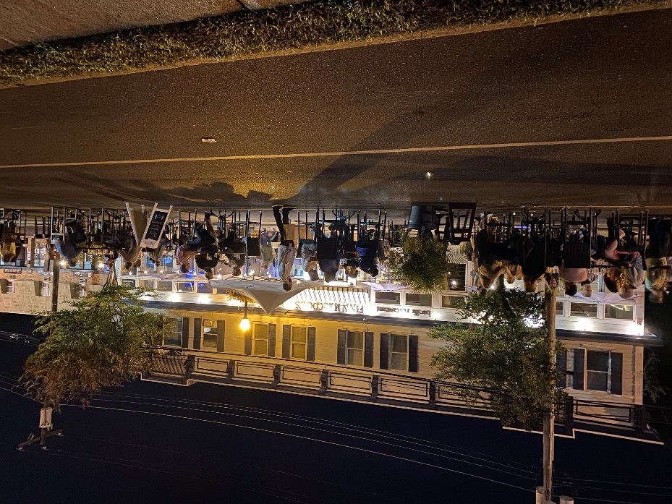
Complete Streets:
COMPLETE STREETS
MARCH 26, 2021

Slide 20
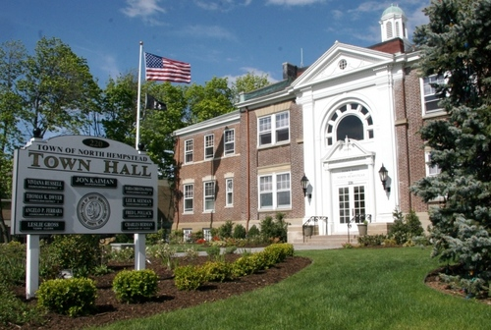
Any Questions?

