Slide 1

The New York Bicycling Coalition in 2021
Daniel Flanzig, Esq.
Vision Long Island
Complete Streets Summit
March 25, 2021

Slide 2
The New York Bicycling Coalition (NYBC) is a 501(c)3 organization founded in 1990 as a coalition of bicycle clubs, transportation professionals and advocacy organizations for the purpose of providing a unified voice for bicyclists in New York State.
The Bulk of NYBC’s funding comes from Grants issued by the Governor’s Traffic Safety Committee (GTSC) for our programming and educational deliverables. The balance of our funding comes from membership, donations, and small grant funding.
A great deal of the work is done by our volunteer board like myself with boots on the ground efforts.
Last month we secured a $25,000.00 grant from the Hagedorn Foundation specifically funded to target Long Island. Why LI?

Slide 3
Problem Identification on Long Island
Long Island leads the State outside NYC in Bicycle related Serious Injuries and Deaths. We are creeping up on NYC
The finalized 2019 ITSMR data shows 49 bicycle fatalities, an increase from 30 fatalities in 2018. There were 5,846 reported personal injuries in 2019, an increase from 5,618 in 2018. The preliminary numbers for bicycle fatalities in 2020 are trending to exceed 2018.
E-Bikes now legal in NY, E-Scooters now legal in NY
Bikes should no longer be thought of as “alternative” transportation but simply as transportation and part of our network.
GOAL
The goal of the New York Bicycle Coalition Long Island Safety Plan is to eliminate bicyclist injuries and fatalities through education, outreach, and communication, prioritizing at-risk demographics and high-crash areas. We also seek to create a collective voice for cyclist on Long Island to advocate for better cycling infrastructure, legislation and enforcement.

Slide 4

Are We Making Progress Here on Long Island?
This Photo by Unknown Author is licensed under CC BY-SA-NC

Slide 5
Nassau and Suffolk Anti-Bike Laws
Last Year Nassau Passed “Reckless Cycling Law”
It criminalized “Ride Outs” and Reckless Riding
Violators, mostly children charged with a Misdemeanor
Allows for Seizure of Bikes
Was this ever Enforced?
My FOIL: (Freedom of Information Law)
1st year of existence 4 Summons written with 0 reduction in bicycle related crashes or deaths
Think this worked?
Suffolk's Proposed Same “reckless cycling” law
First version would have criminalized violations of the VTL ( normally just a summons) Run a red light or stop sign on a bike? Arrest possible.
Second Version, adapted by the Legislators also allowed Police to seize your bike if you run a stop sign. Not just for reckless riding.
County Executive Belone Vetoed this law.
His words, not designed to reach the intended result, making Suffolk safer for cyclists.

Slide 6

And Then Last Week Suffolk County Does This!
Voted “Yes” to a Resolution Sponsored by Legislator Hahn
Res.1830 - “A local law to Ensure the Safety of Cyclists in Suffolk County”
Also Known as a 3 foot law
Currently awaiting Mr. Belone signature
This Photo by Unknown Author is licensed under CC BY-SA-NC

Slide 7
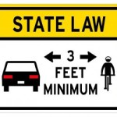
For Over Five Years NYC Has Been Working In Albany to Amend this Law Across the State

Slide 8
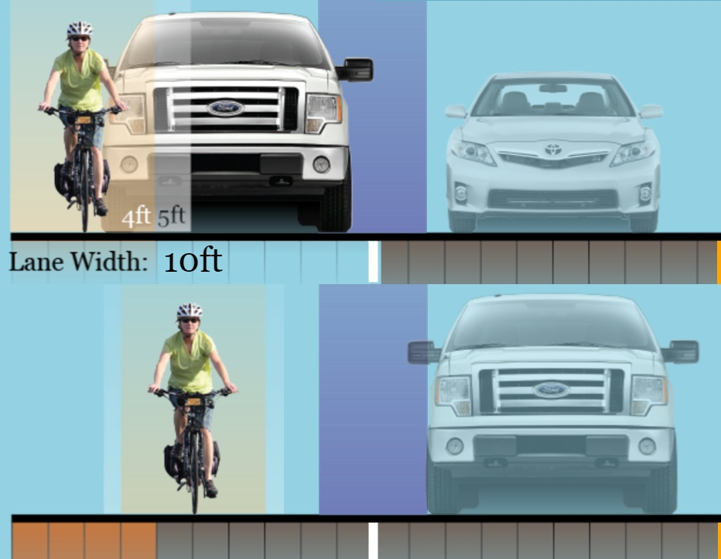
Background
A three foot law requires a motorist to pass a cyclists with no less than 3 feet between the vehicle and rider
The majority of states have adopted at least 3’ as their safe passing standard.
33 states, and D.C., have defined a “safe distance” for a motorist passing a bicyclist as “at least 3 feet.”
There are other states that give cyclist’s even greater protection than the 3’ standard.
Notably, Pennsylvania has a “no less than 4 feet” standard
Some States even require a motorist to change lanes if available while passing a cyclist
.

Slide 9
The Simple Change in the Law
Current version of VTL § 1122-a. entitled Overtaking a bicycle states:
The Amendment: 1122-a: Overtaking a Bicycle
“The driver of a vehicle overtaking another a bicycle proceeding in the same direction shall pass to the left thereof at a safe distance and shall not again drive to the right side of the roadway until safely clear of the overtaken vehicle”.
“The operator of a vehicle overtaking, from behind, a bicycle proceeding on the same side of a roadway shall pass to the left of such bicycle at a distance of not less than 3 feet until safely clear thereof.
Clear and unambiguous language

Slide 10

This the Reality of Riding on Long Island

Slide 11
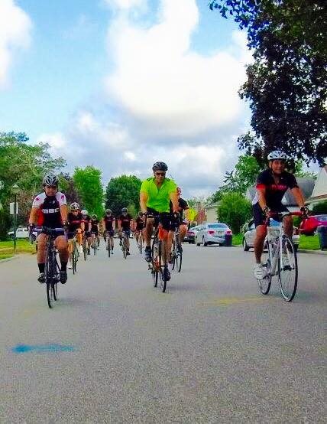
Who does this protect?
When we talk about this amendment, most people think this:

Slide 12
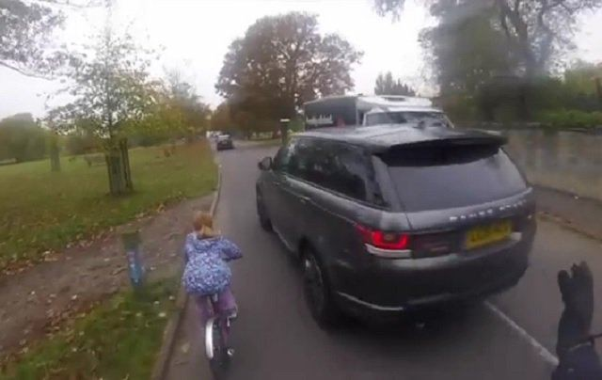
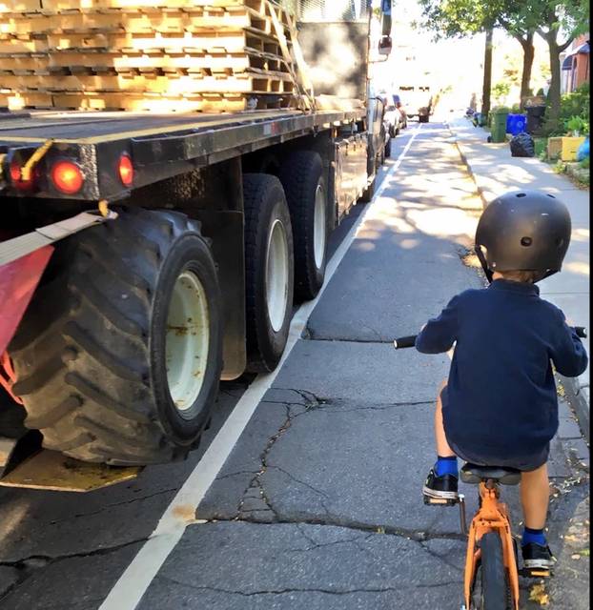
We need to Start thinking this:

Slide 13

And this…

Slide 14
Thank You !
The New York Bicycling Coalition in 2021
Daniel Flanzig, Esq.
Complete Streets Summit
March 24, 2021

