Slide 1

New York Youth Works
Andrew M. Cuomo, Governor

Slide 2
NY Youth Works PROGRAM
$25 million for business tax credits
$8 million for job-readiness training

Slide 3



NY Youth Works – Help for Unemployed Youth
Disadvantaged youth experience higher rates of unemployment
26% of all unemployed workers are under the age of 25
4 out of every 10 disadvantaged youth are looking for work
Unemployment among Hispanic youth in New York State (ages 16-19) is over 35%

Slide 4
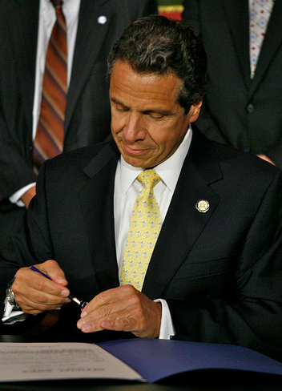
NY Youth Works – Help for Unemployed Youth
December 2011, Governor Cuomo signed legislation to combat high unemployment among inner-city youth
$25M available for businesses that hire unemployed and disadvantaged youth in part-time and full-time positions by December 31, 2012

Slide 5

Participating youth must be:
Between ages of 16 and 24
Low-income or at-risk
Unemployed
Living in a targeted area
Certified youth must start employment by December 31, 2012

Slide 6
Youth are considered low-income or at-risk if they meet one of the following criteria:
Member of family receiving Temporary Assistance for Needy Families (TANF)
Member of family receiving SNAP benefits (food stamps)
Member of family receiving Supplemental Social Security Income (SSI) benefits
Receives free or reduced-cost school lunch
Referred by a state-approved rehabilitation agency or employment network under Ticket to Work Program
Served time in jail or prison – or on probation or parole
Pregnant or a parent
Homeless

Slide 7
Low-income or at-risk criteria (continued):
Veteran
Currently in or will soon be leaving Foster Care or the custody of the NYS Office of Children and Family Services
18 years of age or older without a High School Diploma or GED
Daughter or son of parent who is currently in jail or prison, or has been within past two years
Daughter or son of parent who is collecting Unemployment Insurance
Other relevant factors determined by the Executive
Note – Youth at least 16 years of age but not 18 years old must be in school, attending a secondary school or GED classes, AND must have the permission of their parent or guardian to participate

Slide 8
Low-income or at-risk criteria (continued):
Veteran
Currently in or will soon be leaving Foster Care or the custody of the NYS Office of Children and Family Services
18 years of age or older without a High School Diploma or GED
Daughter or son of parent who is currently in jail or prison, or has been within past two years
Daughter or son of parent who is collecting Unemployment Insurance
Other relevant factors determined by the Executive
Note – Youth at least 16 years of age but not 18 years old must be in school, attending a secondary school or GED classes, AND must have the permission of their parent or guardian to participate

Slide 9

Businesses must be certified to participate and must apply for certification by November 30, 2012
Youth hires must also be certified to participate in order for a business to claim the tax credit
Tax credits apply to the NYS Franchise Tax on Businesses
30
NOVEMBER

Slide 10
Tax Credits to Businesses
Full-Time Hire – 35 hours or more per week, defined by NYSDOL in consultation with Empire State Development Corporation and the NYS Department of Taxation and Finance
Maximum Tax Credit = $4,000
$500 per month for maximum six months ($3,000), and
$1,000 if retained for six months beyond initial six months (one full year)
Part-Time Hire – 20 to 34 hours per week, defined in the authorizing legislation
Maximum Tax Credit = $2,000
$250 per month for maximum six months ($1,500), and
$500 if retained for six months beyond initial six months (one full year)
Seasonal and temporary job openings are eligible as long as they meet eligibility criteria

Slide 11
Certification for Tax Credits
Process
Businesses must be certified to participate
Online and mail-in certification applications submitted to NYSDOL.
Apply and submit the application online, or print it out and mail it. Go to www.youthworks.ny.gov
Help available by phone (877) 226-5724; or by email info@youthworks.ny.gov
Apply for certification by November 30, 2012

Slide 12
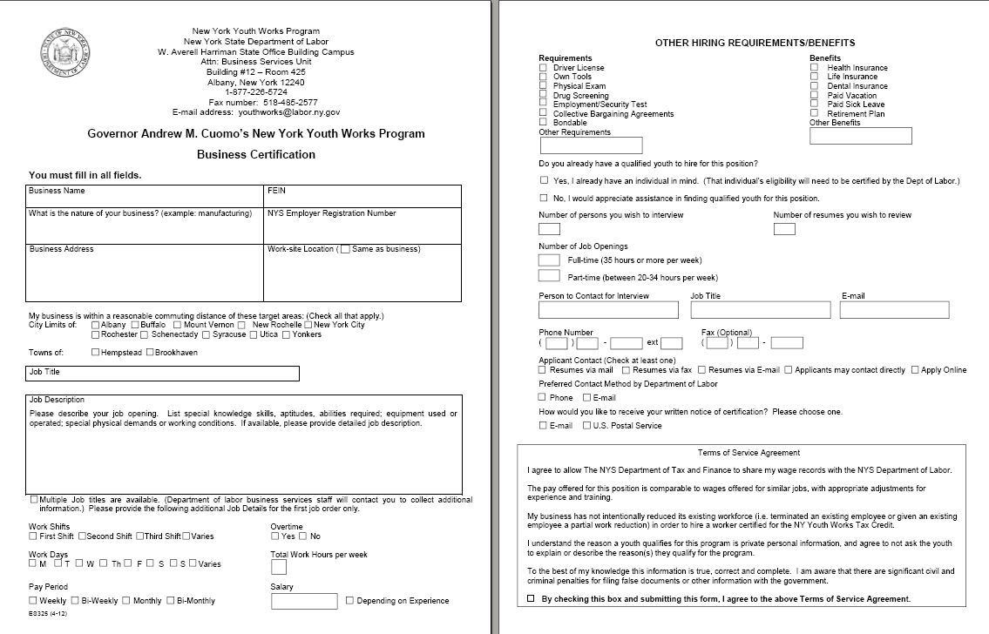

Slide 13
Certification for Tax Credits
Process
All applications processed by NYSDOL
Application review includes due diligence and information validation
Notification to applicant within 3-7 days of receipt of application
As businesses are certified, they are listed on the NYS Job Bank. Viewers can link directly to the NYS Job Bank from the Youth Works web page www.youthworks.ny.gov

Slide 14
Certification for Tax Credits
Business Certification
Criteria
Located within a reasonable commuting distance for eligible youth residing in target areas (1 hour by private transportation or 1½ hours by public transportation)
Filling job openings that meet one of the following factors:
Considered in-demand occupations
In regional growth sectors
Deemed a priority of the Regional Economic Development Council (e.g., Clean Energy, Healthcare, Advanced Manufacturing, Conservation)
Other relevant factors identified by the Executive
Preference to businesses offering advancement and employee benefits

Slide 15
Certification for Tax Credits
Business Certification
Application Data
Business Name/Address/Contact
Federal Employer Identification Number and NYS Employer Registration Number
Worksite, Job Title(s), and Job Description(s)
# Openings, F/T or P/T, Work Days and Hours, and Wage Rate
Other Requirements/Benefits (e.g., driver’s license, physical, health coverage)
Businesses must agree to Terms of Service
NYS Department of Tax & Finance is allowed to share the business’ wage records with NYSDOL
The pay offered for the position is comparable to wages offered for similar jobs with adjustments for experience and training

Slide 16
Certification for Tax Credits
Business Certification
Approved Businesses
Certificate will be mailed or e-mailed based on business preference
Certificate will list the job openings to be filled and potential tax credit amount that may be earned
Upon hiring a youth, business must submit a ‘Hire Confirmation’ form; business will then receive a ‘Confirmation of Hire Certificate’ stating the maximum potential tax credit that may be claimed

Slide 17
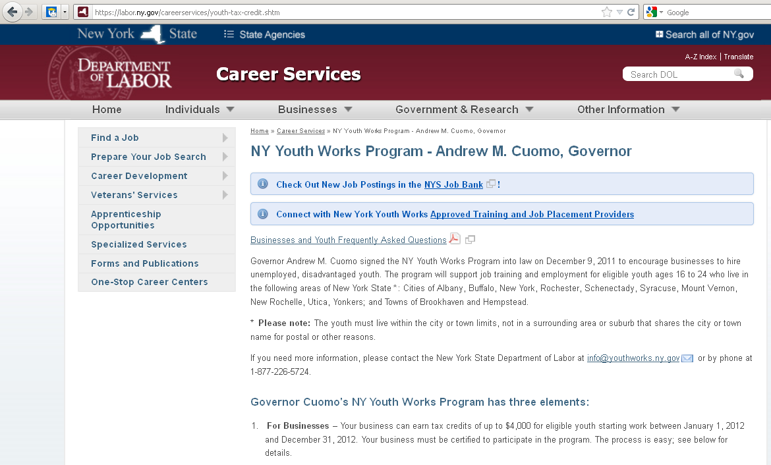
www. youthworks.ny.gov

Slide 18
Questions or Assistance
NYS Department of Labor
(877) 226-5724
www. youthworks.ny.gov
Mark J. Grossman
Commissioner’s Long Island Representative
(631) 687-4823 • mark.grossman@labor.ny.gov

